Slide 1
Universal Gates
Created by-
Sradha and shivam

Slide 2
What are Universal Gates And why NAND and NOR Gates are called so?
A Gate which can be used to create any logic system is called Universal Gate.
NAND gate is simply the inverted AND gate while NOR gate is simply the inverted OR gate.
Any Gate can be implemented by using NAND and NOR gates and thus they are called Universal Gates.

Slide 3
Proof for NAND gate
We know AND,OR,NOT gates are used to make any Boolean function.
AND,OR,NOT gates can be implemented using NAND gate.
Hence, NAND gate can implement any Boolean function.

Slide 4
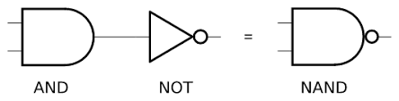
NAND = NOT + AND Truth table for NAND GATE
A | B | A AND B | A NAND B
0 | 0 | 0 | 1
0 | 1 | 0 | 1
1 | 0 | 0 | 1
1 | 1 | 1 | 0

Slide 5
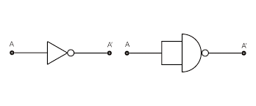
Implementation of not using NAND
A NOT gate is made by joining the inputs of NAND gate together.
Truth Table for NOT :
(A.A)’ = A’
INPUT | OUTPUT
0 | 1
1 | 0

Slide 6
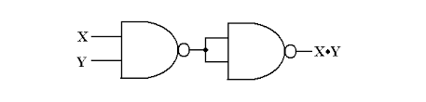
Implementation of AND using NAND
A NAND gate is an inverted AND gate.
An AND gate is made by following a NAND gate with a NOT gate.
Truth Table for AND :
= ((X.Y)’.(X.Y)’)’
= (( X’+Y’).(X’+Y’))’
= (X’+Y’)’ + (X’+Y’)’
= (X’’.Y’’) + (X’’.Y’’)
= X.Y+X.Y = X.Y
A | B | A AND B
0 | 0 | 0
0 | 1 | 0
1 | 0 | 0
1 | 1 | 1

Slide 7
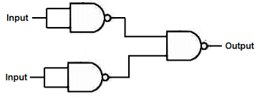
Implementation of OR using NAND
If the truth table for a NAND gate is examined or by applying De Morgan's Laws, it can be seen that if any of the inputs are 0, then the output will be 1.
Truth Table for OR:
((X.X)’.(Y.Y)’)’ = (X’.Y’)’
= (X” + Y”)
= X + Y
A | B | A OR B
0 | 0 | 0
0 | 1 | 1
1 | 0 | 1
1 | 1 | 1

Slide 8
Proof for NOR gate
We know AND,OR,NOT gates are used to make any Boolean function.
AND,OR,NOT gates can be implemented using NOR gate.
Hence, NOR gate can implement any Boolean function.

Slide 9
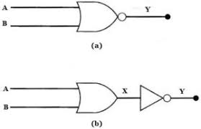
NOR = NOT + OR Truth table for NOR GATE
A | B | A OR B | A NOR B
0 | 0 | 0 | 1
0 | 1 | 1 | 0
1 | 0 | 1 | 0
1 | 1 | 1 | 0

Slide 10
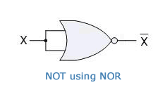
Implementation of NOT using NOR
A NOT gate is made by joining the inputs of NOR gate together.
Truth Table for NOT :
(X+X)’ = X’
INPUT | OUTPUT
0 | 1
1 | 0

Slide 11
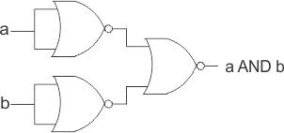
Implementation of AND using NOR
3 NOR gate is used to form AND gate.
An AND gate is made by following a NOR gates.
Truth Table for AND :
= ((X+X)’+(Y+Y)’)’
= (( X’.X’)+(Y’.Y’))’
= (X’.X’)’ . (Y’.Y’)’
= (X’’+X’’) . (Y’’+Y’’)
= (X+X) . (Y+Y) = X.Y
A | B | A AND B
0 | 0 | 0
0 | 1 | 0
1 | 0 | 0
1 | 1 | 1

Slide 12
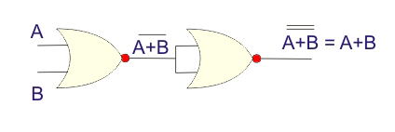
Implementation of OR using NOR
NOR gate is inverted OR gate.
OR gate can be created by using 2 NOR gates.
Truth Table for OR:
((A+B)’+(A+B)’)’=((A+B)’’.(A+B)’’)
=(A+B).(A+B)
= A+B
A | B | A OR B
0 | 0 | 0
0 | 1 | 1
1 | 0 | 1
1 | 1 | 1

Slide 13
THANK YOU !

